Slide 1
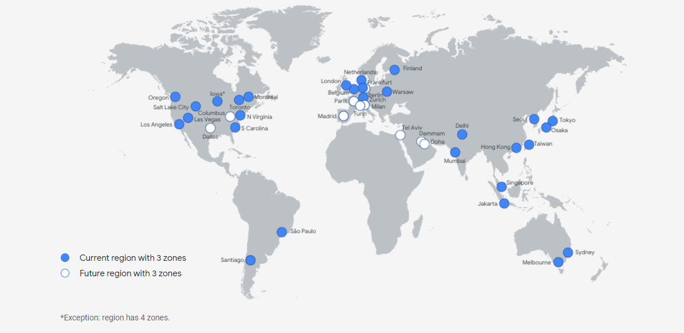
Google Data Center

Slide 2
What are Google Data centers?
Google data centers are the huge data center facilities that Google uses to provide their services which combine large drives internal and external networking, environmental controls that can be mainly cooling and humidification control
Gartner estimated in a July 2016 report that Google at the time had 2.5 million servers.

Slide 3
Distributed Structure
Rather than storing each user's data on a single machine or set of machines, we distribute all data — including our own — across many computers in different locations. We then chunk and replicate the data over multiple systems to avoid a single point of failure. We name these data chunks randomly, as an extra measure of security, making them unreadable to the human eye.
Google data centers are protected with several layers of security to prevent any unauthorized access to data. They use secure perimeter defense systems, comprehensive camera coverage, biometric authentication, and a 24/7 guard staff

Slide 4
How are Google data centers powered?
Google data centers use much less energy than the typical data center.
Cooling is done by outside air and not refrigerants
Encourage other companies to do so.
100% Carbon-free energy by 2030

Slide 5
Total 23 centres 2 in Asia at Taiwan & Singapore
On July 2016 there were 2.5 million servers
Data center network topology : To support fault tolerance, increase the scale of data centers and accommodate low-radix switches, Google has adopted various modified Clos topologies in the past.
In 2018, data centers will store an estimated 547 exabytes of actual data
Running no less than two routers per datacenter (for redundancy) we can conclude that the Google network scales in the terabit per second range (with two fully loaded routers the bi-sectional bandwidth amount to 1,280 Gbit/s)

